Slide 1
12
The Central Nervous System: Part B

Slide 2
Lateralization of Cortical Function
Hemispheres almost identical
Lateralization - division of labor between hemispheres
Cerebral dominance - hemisphere dominant for language (left hemisphere - 90% people)

Slide 3
Lateralization of Cortical Function
Left hemisphere
  Controls language, math, and logic
Right hemisphere
  Visual-spatial skills, intuition, emotion, and artistic and musical skills
Hemispheres communicate almost instantaneously via fiber tracts and functional integration

Slide 4
Cerebral White Matter
Myelinated fibers and tracts
Communication between cerebral areas, and between cortex and lower CNS
  Association fibers— horizontal; connect different parts of same hemisphere
  Commissural fibers— horizontal; connect gray matter of two hemispheres
  Projection fibers— vertical; connect hemispheres with lower brain or spinal cord

Slide 5
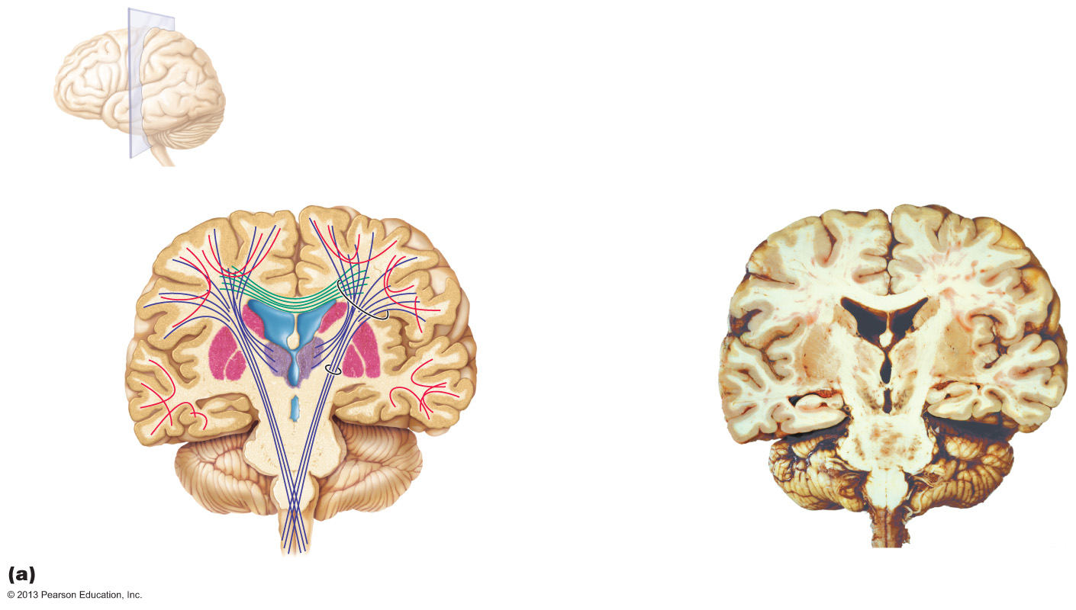
Figure 12.8a White fiber tracts of the cerebral hemispheres.
Association fibers
(within hemisphere)
Longitudinal fissure
Superior
Commissural fibers
(between hemispheres)
Lateral
ventricle
• Corpus callosum
Basal nuclei
• Caudate
• Putamen
• Globus
pallidus
Projection fibers
(cerebral cortex
to lower area)
• Corona
radiata
• Internal
capsule
Thalamus
Gray matter
Third
ventricle
White matter
Pons
Medulla oblongata
Decussation
(cross-over)
of pyramids
Frontal section

Slide 6
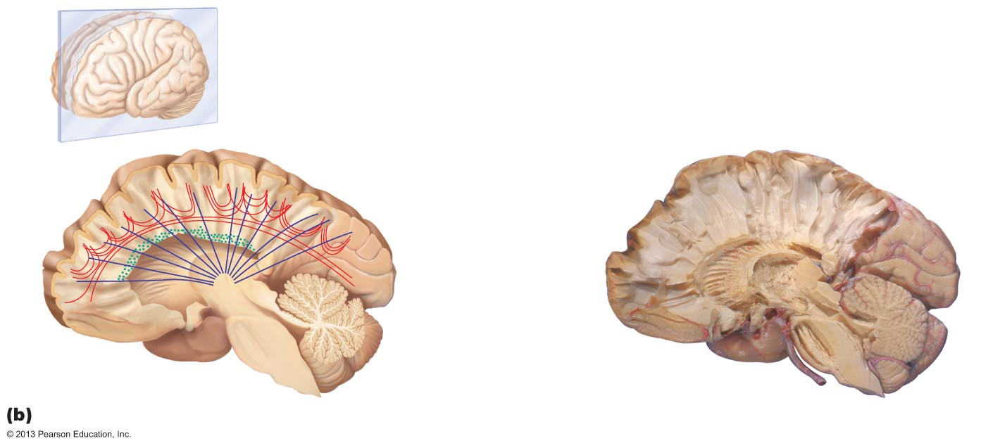
Figure 12.8b White fiber tracts of the cerebral hemispheres.
Association fibers
Gray
matter
Commissural fibers
• Corpus callosum
Projection fibers
• Corona radiata
• Internal capsule
Parasagittal section and dissection

Slide 7
Basal Nuclei (Ganglia)
Subcortical nuclei
  Caudate nucleus
  Putamen
  Globus pallidus
Caudate nucleus + putamen = striatum
Associated with subthalamic nuclei (diencephalon) and substantia nigra (midbrain)

Slide 8
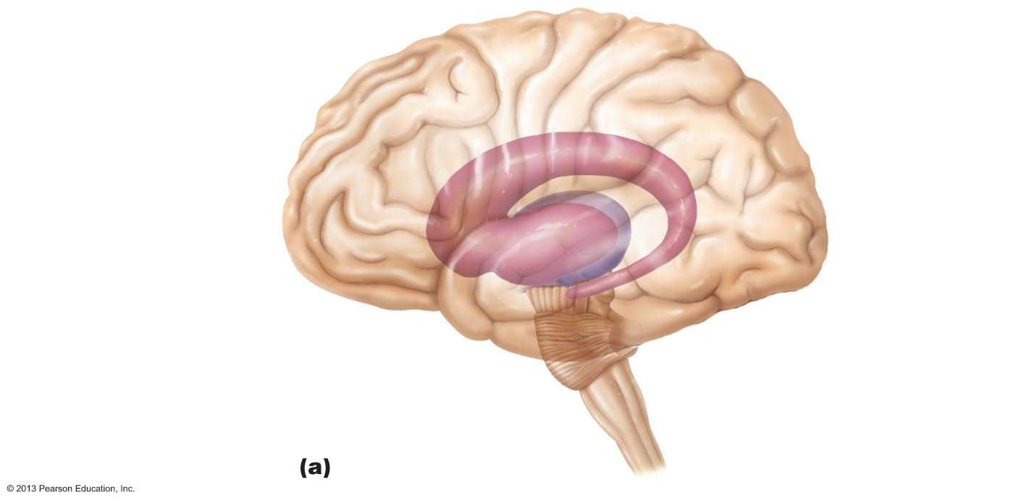
Figure 12.9a Basal nuclei.
Caudate
nucleus
Striatum
Thalamus
Putamen
Tail of caudate
nucleus

Slide 9
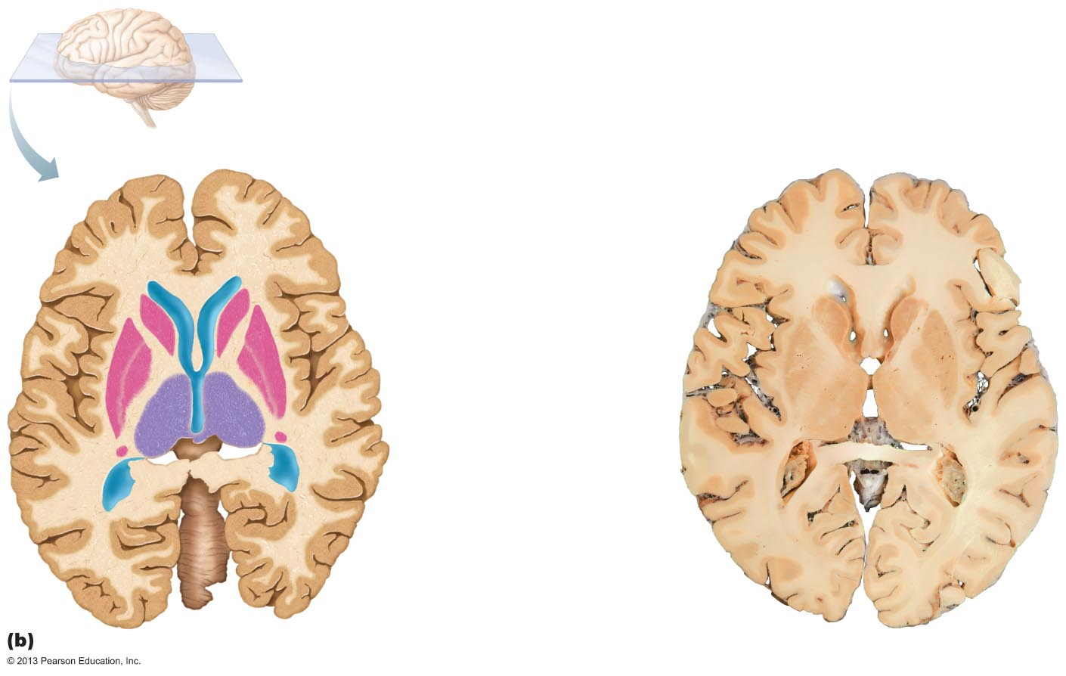
Figure 12.9b Basal nuclei.
Anterior
Cerebral cortex
Cerebral white matter
Corpus callosum
Anterior horn
of lateral ventricle
Head of caudate nucleus
Putamen
Globus
pallidus
Thalamus
Tail of caudate nucleus
Third ventricle
Inferior horn
of lateral ventricle
Posterior

Slide 10
Functions of Basal Nuclei
Functions thought to be
  Influence muscle movements
  Role in cognition and emotion
  Regulate intensity of slow or stereotyped movements
  Filter out incorrect/inappropriate responses
  Inhibit antagonistic/unnecessary movements

Slide 11
Diencephalon
Three paired structures
  Thalamus
  Hypothalamus
  Epithalamus
Encloses third ventricle
PLAY
Animation: Rotatable brain (sectioned)

Slide 12
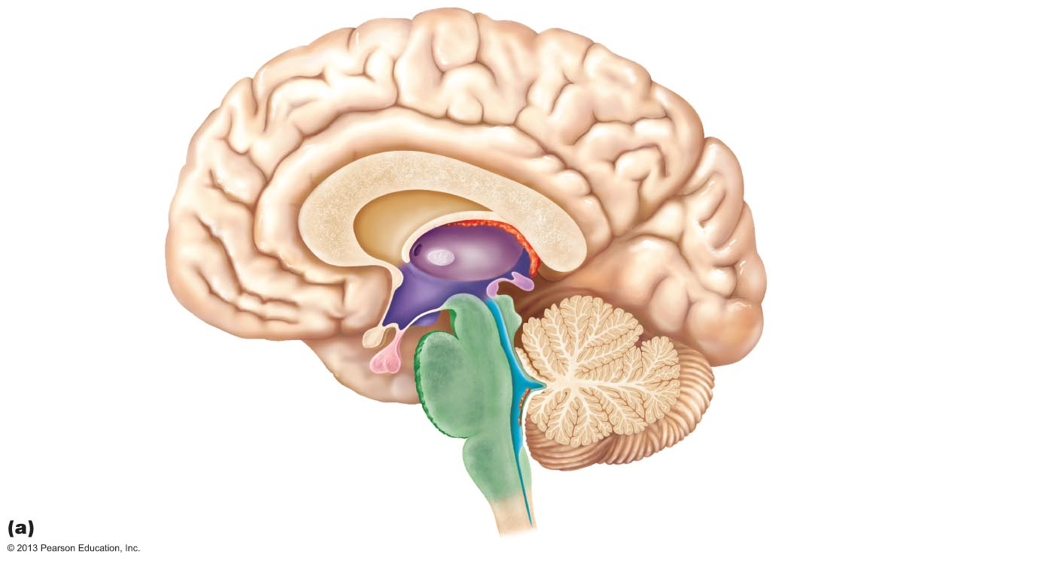
Figure 12.10a Midsagittal section of the brain.
Cerebral hemisphere
Corpus callosum
Septum pellucidum
Fornix
Interthalamic
adhesion
(intermediate
mass of thalamus)
Choroid plexus
Thalamus
(encloses third ventricle)
Interventricular
foramen
Posterior
commissure
Epithalamus
Anterior
commissure
Pineal gland
Corpora
quadrigemina
Hypothalamus
Midbrain
Optic chiasma
Cerebral
aqueduct
Pituitary gland
Arbor vitae (of cerebellum)
Mammillary
body
Fourth ventricle
Pons
Choroid plexus
Medulla
oblongata
Cerebellum
Spinal cord

Slide 13
Thalamus
80% of diencephalon
Superolateral walls of third ventricle
Bilateral nuclei connected by interthalamic adhesion (intermediate mass)
  Contains several nuclei, named for location
  Nuclei project and receive fibers from cerebral cortex

Slide 14
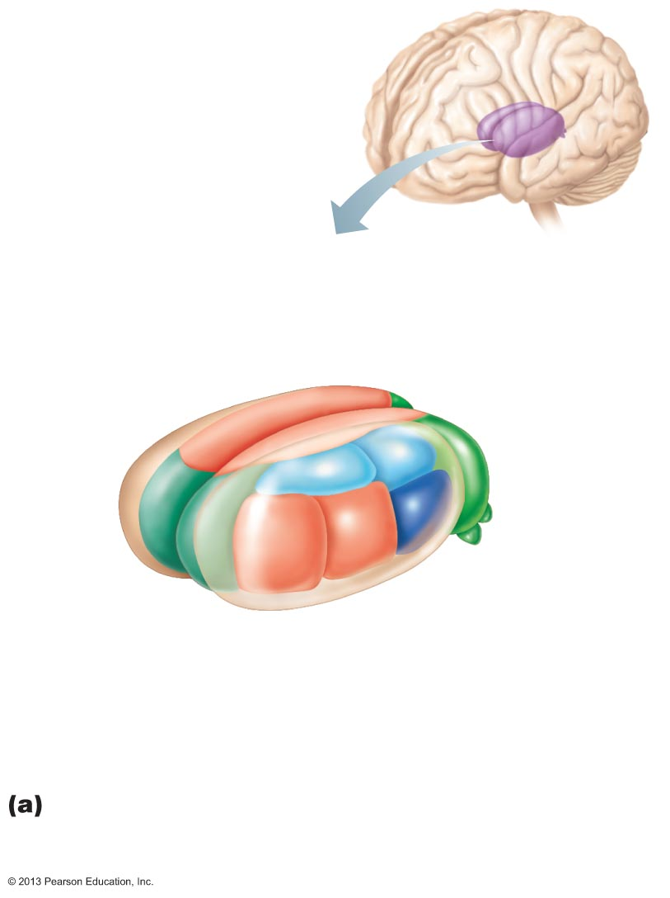
Figure 12.11a Selected structures of the diencephalon.
Medial
dorsal
nucleus
Lateral
dorsal
nucleus
Lateral
posterior
nucleus
Pulvinar
Anterior
nuclei
Medial
geniculate
body
Reticular
nucleus
Lateral
geniculate
body
Ventral
postero-
lateral
Ventral
anterior
Ventral
lateral
Ventral nuclei
The main thalamic nuclei. (The reticular nuclei
that “cap” the thalamus laterally are depicted as
curving translucent structures.)

Slide 15
Thalamic Function
Gateway to cerebral cortex
Sorts, edits, and relays ascending input
  Impulses from hypothalamus for regulation of emotion and visceral function
  Impulses from cerebellum and basal nuclei to help direct motor cortices
  Impulses for memory or sensory integration
Mediates sensation, motor activities, cortical arousal, learning, and memory

Slide 16
Hypothalamus
Forms inferolateral walls of third ventricle
Contains many nuclei
  Example: mammillary bodies
    Paired anterior nuclei
    Olfactory relay stations
Infundibulum—stalk that connects to pituitary gland

Slide 17
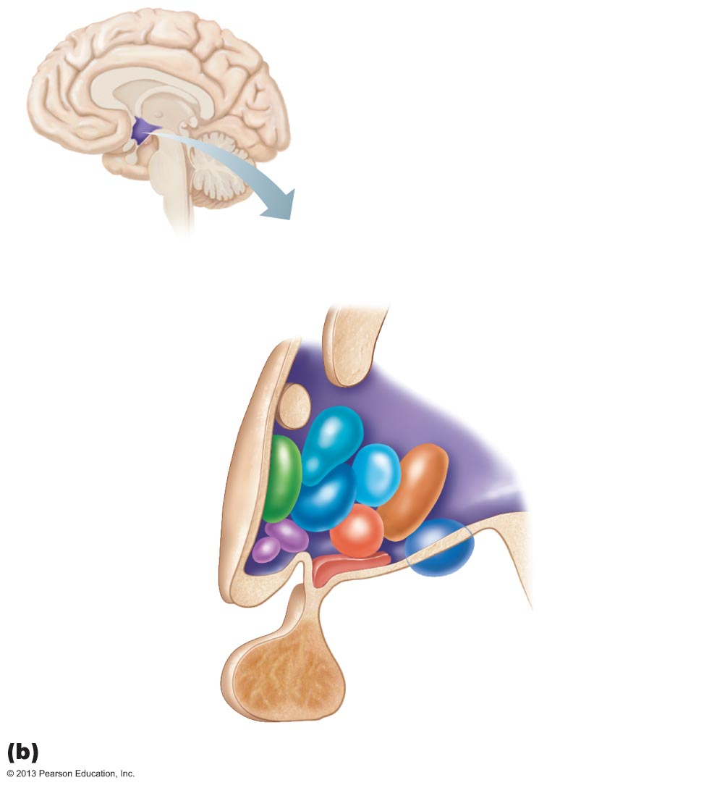
Figure 12.11b Selected structures of the diencephalon.
Paraventricular
nucleus
Anterior
commissure
Fornix
Dorsomedial
nucleus
Preoptic
nucleus
Posterior
hypothalamic
nucleus
Anterior
hypothalamic
nucleus
Lateral
hypothalamic
area
Supraoptic
nucleus
Suprachiasmatic
nucleus
Ventromedial
nucleus
Optic
chiasma
Arcuate
nucleus
Mammillary
body
Infundibulum
(stalk of the
pituitary gland)
Pituitary
gland
The main hypothalamic nuclei.

Slide 18
Hypothalamic Function
Controls autonomic nervous system (e.g., blood pressure, rate and force of heartbeat, digestive tract motility, pupil size)
Physical responses to emotions (limbic system)
  Perception of pleasure, fear, and rage, and in biological rhythms and drives

Slide 19
Hypothalamic Function
Regulates body temperature – sweating/shivering
Regulates hunger and satiety in response to nutrient blood levels or hormones
Regulates water balance and thirst

Slide 20
Hypothalamic Function
Regulates sleep-wake cycles
  Suprachiasmatic nucleus (biological clock)
Controls endocrine system
  Controls secretions of anterior pituitary gland
  Produces posterior pituitary hormones

Slide 21
Epithalamus
Most dorsal portion of diencephalon; forms roof of third ventricle
Pineal gland (body)—extends from posterior border and secretes melatonin
  Melatonin—helps regulate sleep-wake cycle

Slide 22
Figure 12.10a Midsagittal section of the brain.
Cerebral hemisphere
Corpus callosum
Septum pellucidum
Fornix
Interthalamic
adhesion
(intermediate
mass of thalamus)
Choroid plexus
Thalamus
(encloses third ventricle)
Interventricular
foramen
Posterior
commissure
Epithalamus
Anterior
commissure
Pineal gland
Corpora
quadrigemina
Hypothalamus
Midbrain
Optic chiasma
Cerebral
aqueduct
Pituitary gland
Arbor vitae (of cerebellum)
Mammillary
body
Fourth ventricle
Pons
Choroid plexus
Medulla
oblongata
Cerebellum
Spinal cord

Slide 23
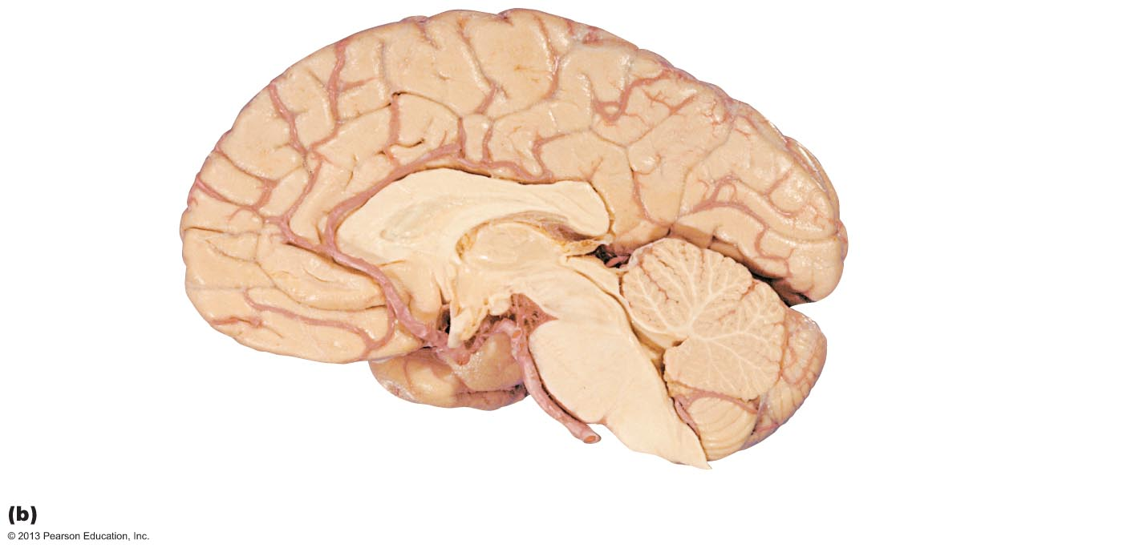
Figure 12.10b Midsagittal section of the brain.
Corpus callosum
Fornix
Lateral ventricle
(covered by septum
pellucidum)
Thalamus
Posterior
commissure
Epithalamus
Third ventricle
Pineal gland
Anterior
commissure
Corpora
quadrigemina
Cerebral
aqueduct
Midbrain
Hypothalamus
Arbor vitae
Fourth ventricle
Optic chiasma
Cerebellum
Mammillary body
Pons
Medulla oblongata

Slide 24
Brain Stem
Three regions
  Midbrain
  Pons
  Medulla oblongata

Slide 25
Brain Stem
Similar structure to spinal cord but contains nuclei embedded in white matter
Controls automatic behaviors necessary for survival
Contains fiber tracts connecting higher and lower neural centers
Nuclei associated with 10 of the 12 pairs of cranial nerves

Slide 26
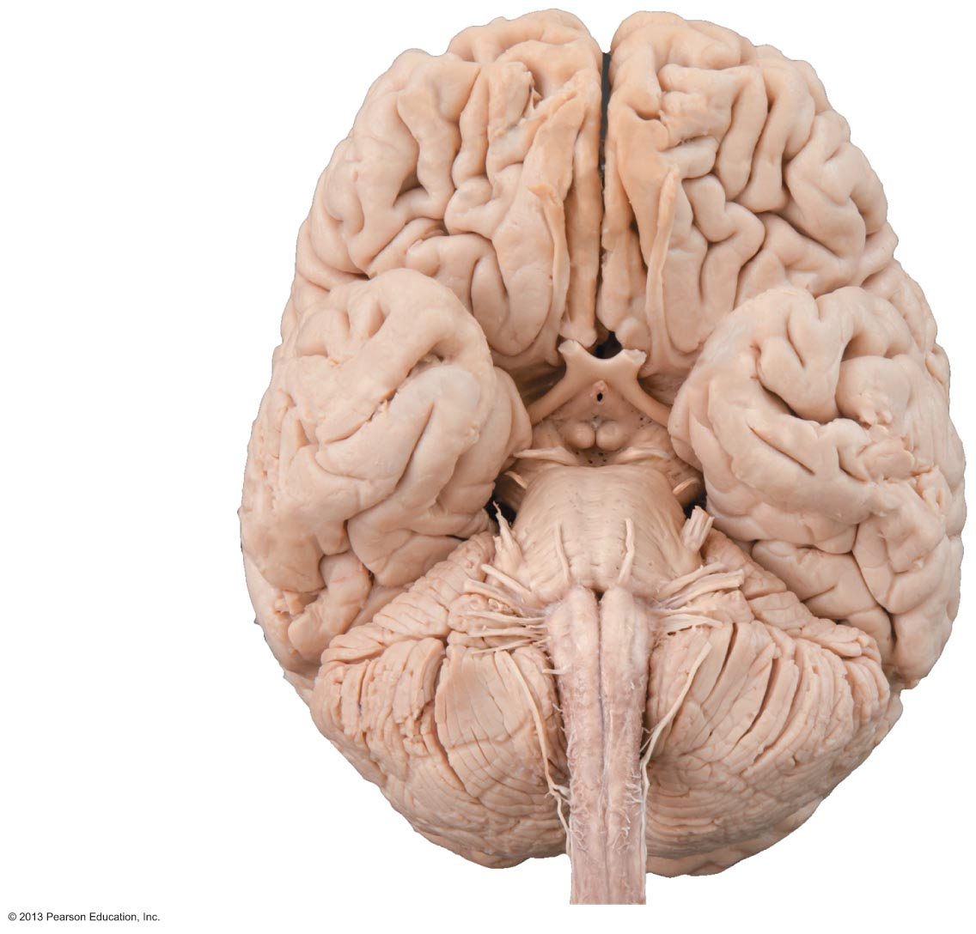
Figure 12.12 Inferior view of the brain, showing the three parts of the brain stem: midbrain, pons, and medulla oblongata.
Frontal lobe
Olfactory bulb
(synapse point of
cranial nerve I)
Optic chiasma
Optic nerve (II)
Optic tract
Mammillary body
Midbrain
Pons
Temporal
lobe
Medulla
oblongata
Cerebellum
Spinal cord

Slide 27
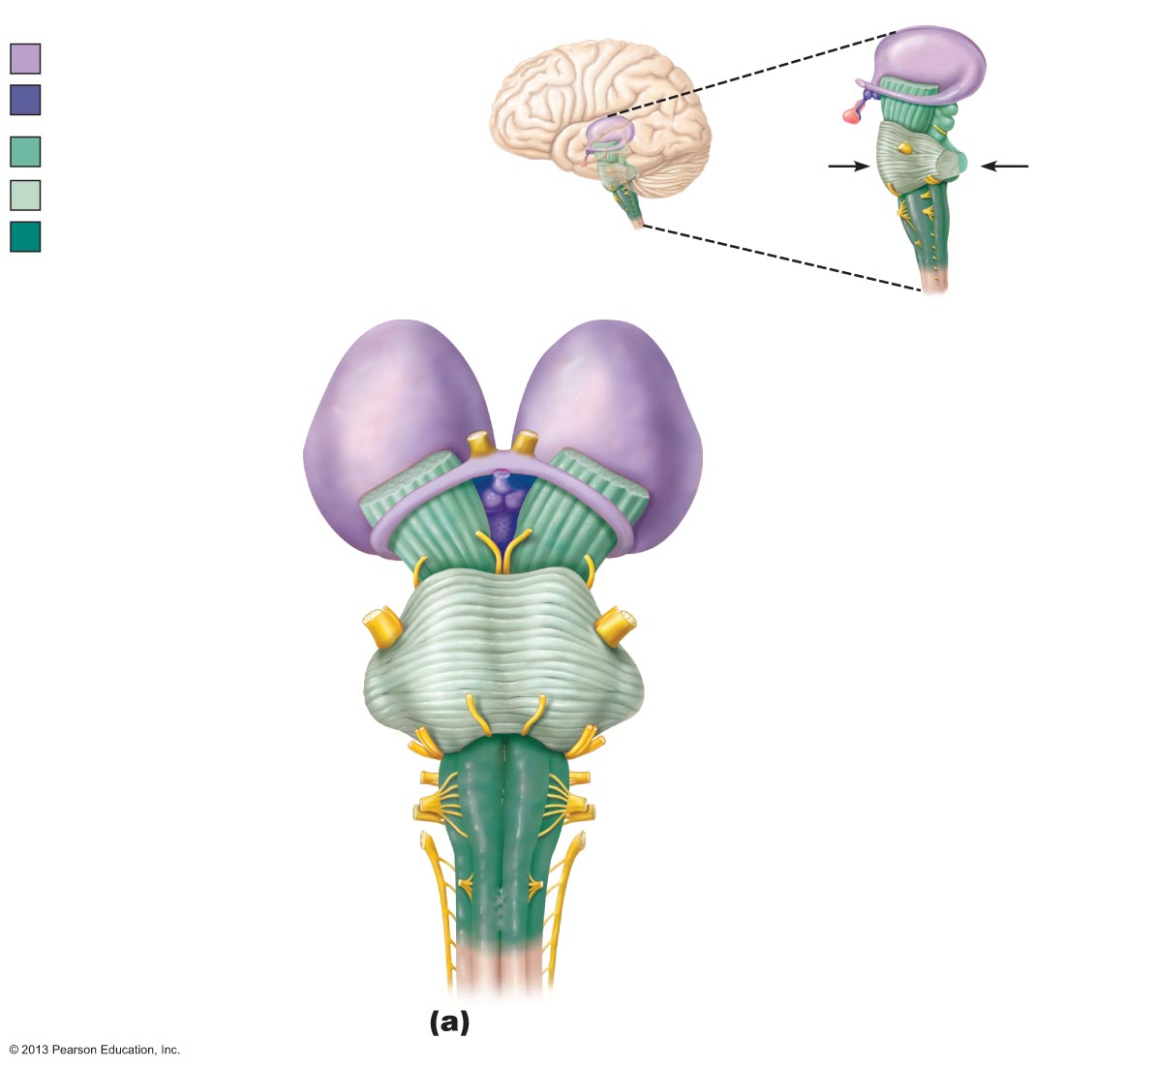
Figure 12.13a Three views of the brain stem (green) and the diencephalon (purple).
Thalamus
Hypothalamus
Diencephalon
Midbrain
View (a)
View (c)
Pons
Brain stem
Medulla
oblongata
View (b)
Diencephalon
Optic chiasma
• Thalamus
Optic nerve (II)
• Hypothalamus
Optic tract
Mammillary body
Oculomotor nerve (III)
Crus cerebri of cerebral
peduncles (midbrain)
Trochlear nerve (IV)
Middle cerebellar
peduncle
Trigeminal nerve (V)
Pons
Abducens
nerve (VI)
Facial nerve (VII)
Vestibulocochlear
nerve (VIII)
Glossopharyngeal nerve (IX)
Hypoglossal nerve (XII)
Pyramid
Vagus nerve (X)
Ventral root of first
cervical nerve
Accessory nerve (XI)
Decussation of
pyramids
Spinal cord
Ventral view

Slide 28
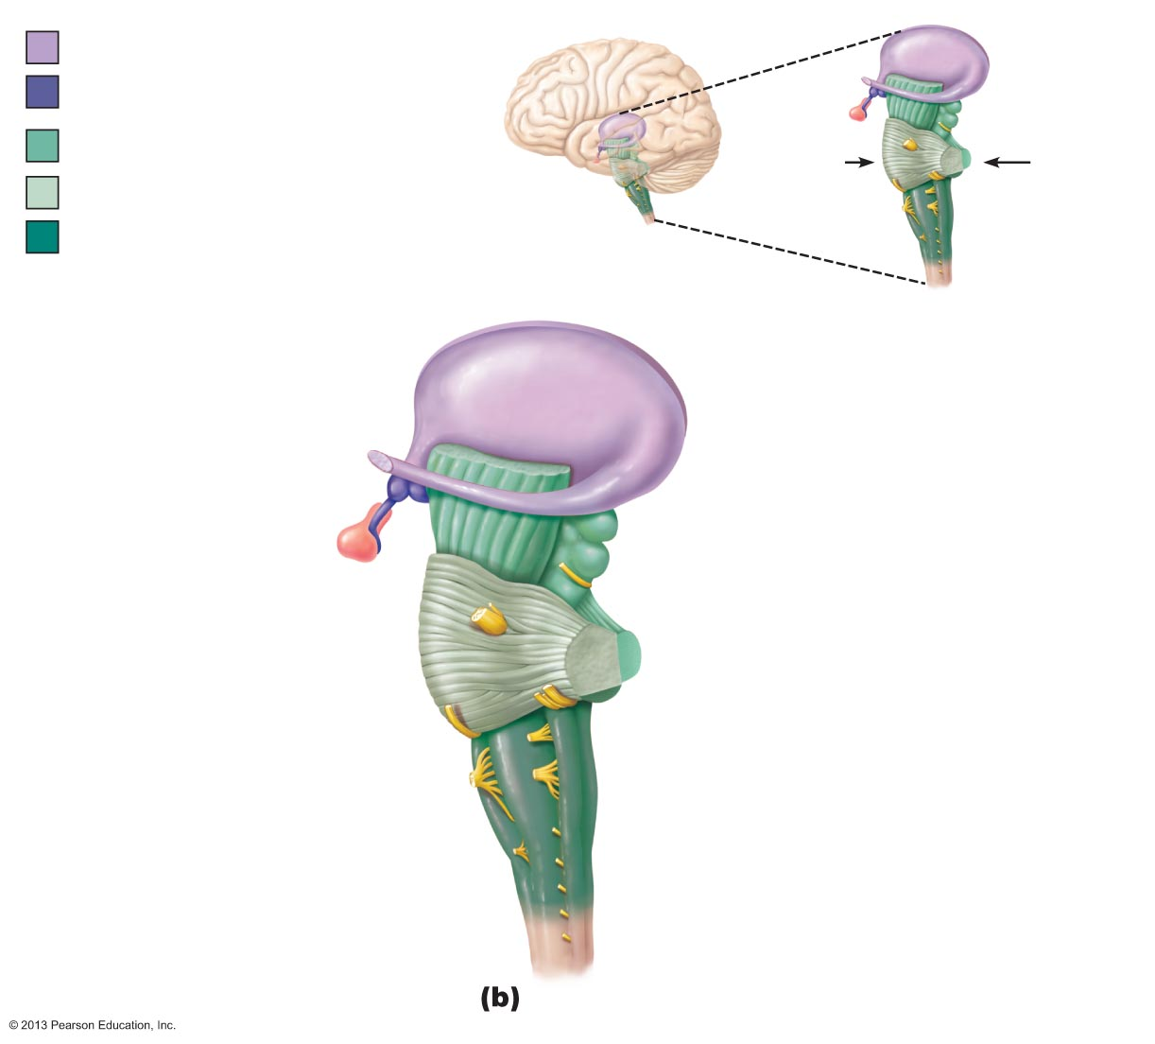
Figure 12.13b Three views of the brain stem (green) and the diencephalon (purple).
Thalamus
Hypothalamus
Diencephalon
Midbrain
View (a)
View (c)
Pons
Brain stem
Medulla
oblongata
View (b)
Optic tract
Thalamus
Infundibulum
Pituitary gland
Superior colliculus
Crus cerebri of cerebral
peduncles (midbrain)
Inferior colliculus
Trochlear nerve (IV)
Trigeminal nerve (V)
Superior cerebellar peduncle
Pons
Middle cerebellar peduncle
Facial nerve (VII)
Inferior cerebellar peduncle
Abducens nerve (VI)
Vestibulocochlear nerve (VIII)
Olive
Glossopharyngeal nerve (IX)
Hypoglossal nerve (XII)
Vagus nerve (X)
Accessory nerve (XI)
Left lateral view

Slide 29
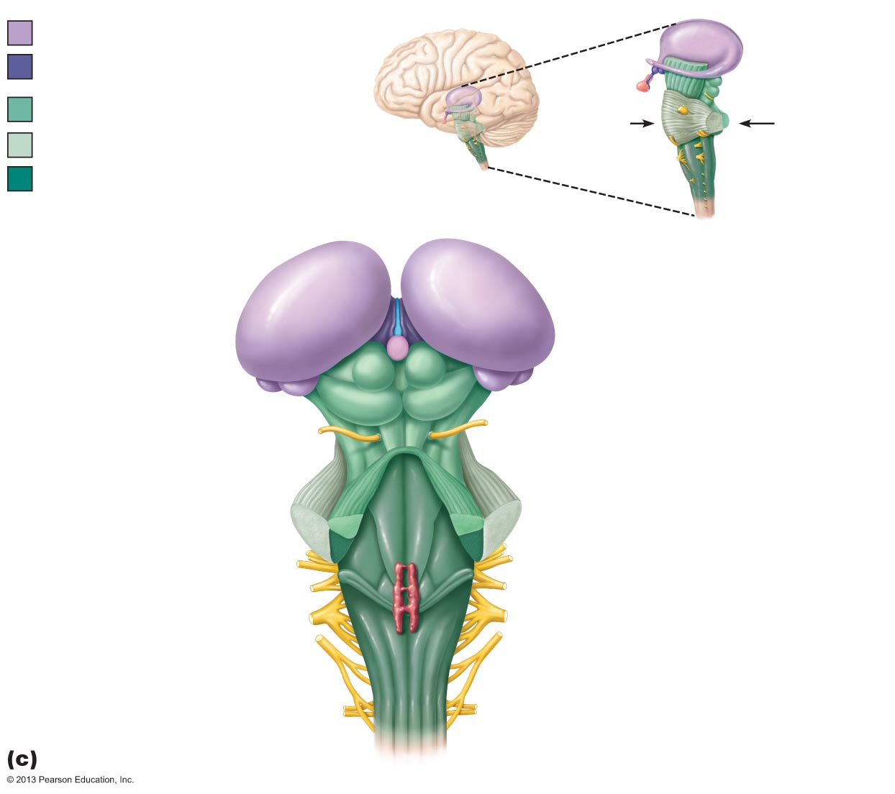
Figure 12.13c Three views of the brain stem (green) and the diencephalon (purple).
Thalamus
Hypothalamus
Diencephalon
Midbrain
View (a)
View (c)
Pons
Brain stem
Medulla
oblongata
View (b)
Thalamus
Diencephalon
Midbrain
• Superior
colliculus
Corpora
quadrigemina
of tectum
• Inferior
colliculus
Pineal gland
• Trochlear nerve (IV)
• Superior cerebellar peduncle
Pons
Floor of
fourth ventricle
• Middle cerebellar peduncle
Medulla oblongata
Facial nerve (VII)
• Inferior cerebellar peduncle
Choroid plexus
(fourth ventricle)
• Vestibulocochlear nerve (VIII)
• Glossopharyngeal nerve (IX)
Dorsal median sulcus
• Vagus nerve (X)
• Accessory nerve (XI)
Dorsal root of
first cervical nerve
Dorsal view

Slide 30
Midbrain
Between diencephalon and pons
Cerebral peduncles ventrally
  Contain pyramidal motor tracts
Cerebral aqueduct
  Channel connecting third and fourth ventricles

Slide 31
Midbrain Nuclei
Periaqueductal gray matter
  Pain suppression; links amygdaloid body and ANS; controls cranial nerves III (oculomotor) and IV (trochlear)
Corpora quadrigemina— dorsal protrusions
  Superior colliculi—visual reflex centers
  Inferior colliculi—auditory relay centers
Substantia nigra—functionally linked to basal nuclei
Red nucleus—relay nuclei for some descending motor pathways; part of reticular formation

Slide 32
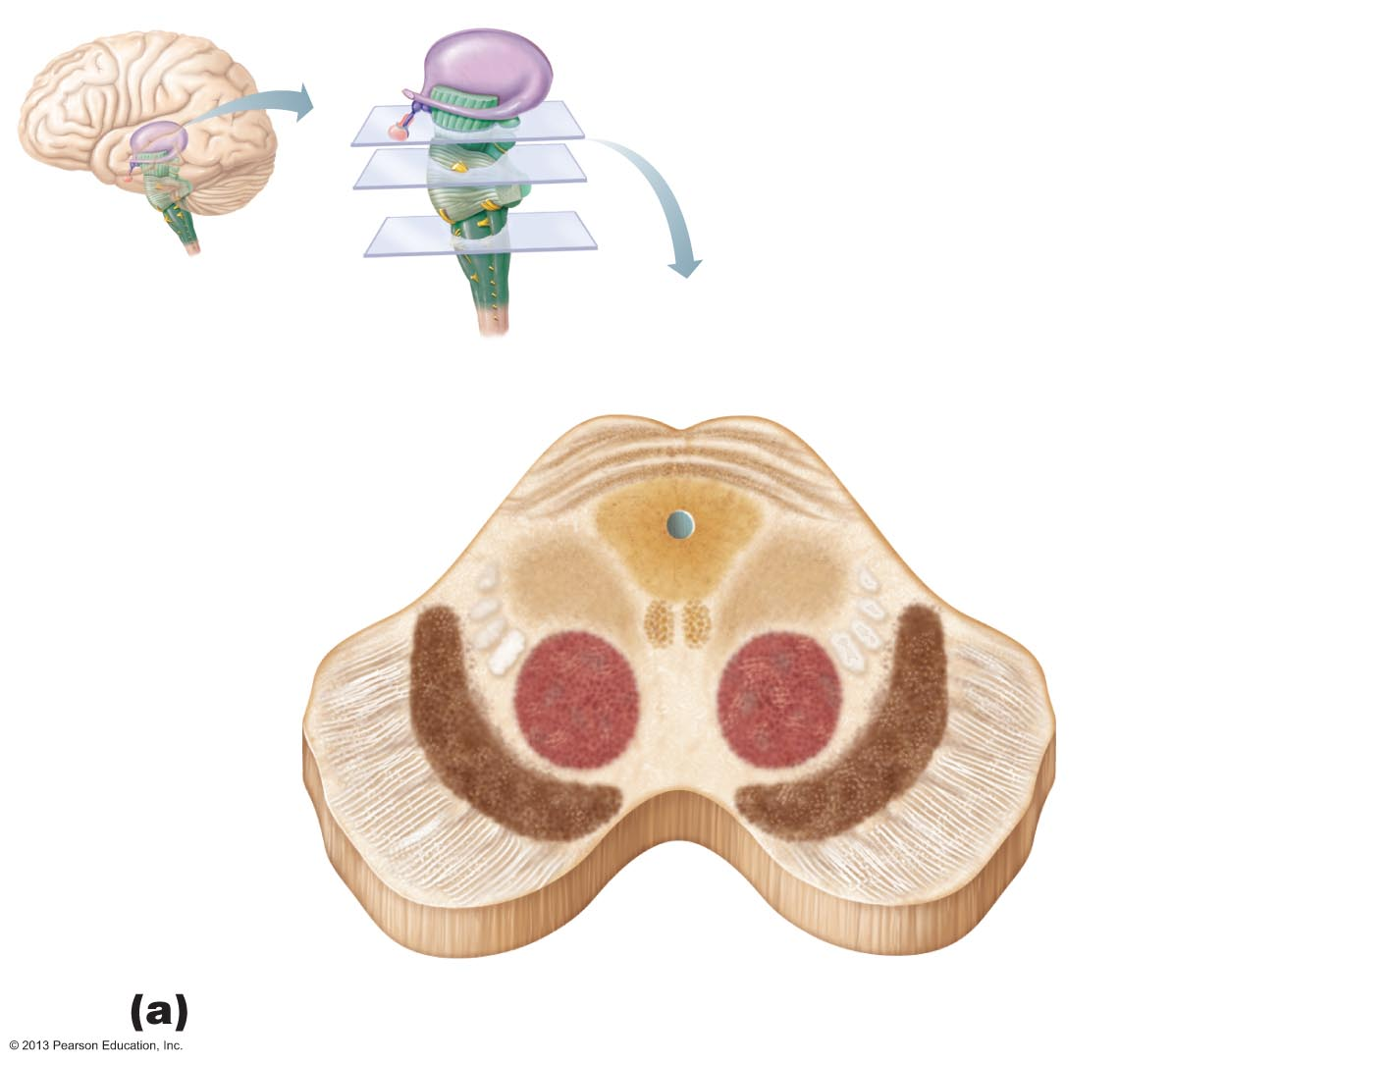
Figure 12.14a Cross sections through different regions of the brain stem.
Tectum
Dorsal
Superior
colliculus
Periaqueductal gray
matter
Cerebral aqueduct
Oculomotor
nucleus (III)
Reticular formation
Medial
lemniscus
Red
nucleus
Substantia
nigra
Fibers of
pyramidal tract
Ventral
Crus cerebri of
cerebral peduncle
Midbrain

Slide 33
Pons
Fourth ventricle seperates pons and cerebellum
Fibers of pons
  Connect higher brain centers and spinal cord
  Relay impulses between motor cortex and cerebellum
Origin of cranial nerves V (trigeminal), VI (abducens), and VII (facial)
Some nuclei of reticular formation
Nuclei help maintain normal rhythm of breathing

Slide 34
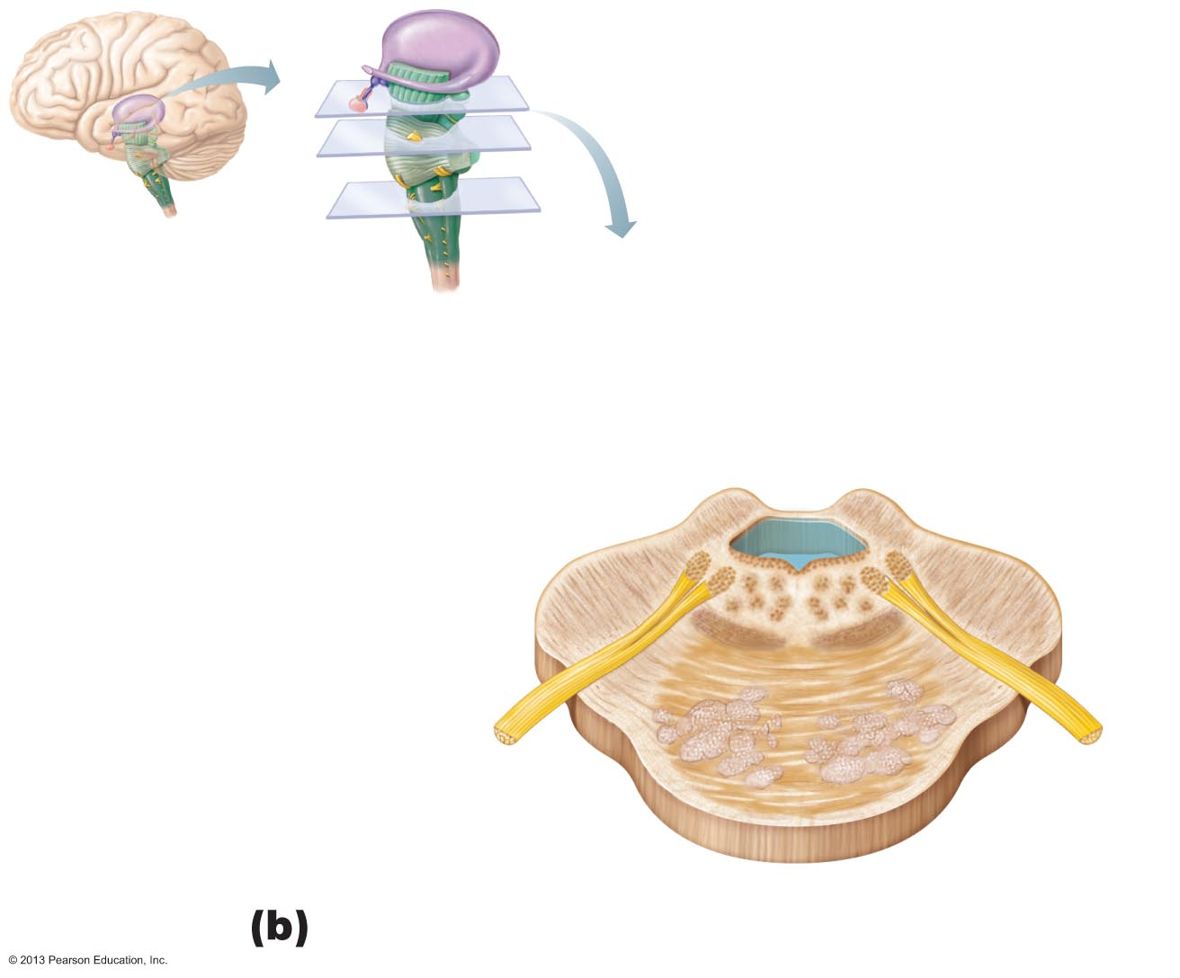
Figure 12.14b Cross sections through different regions of the brain stem.
Superior cerebellar
peduncle
Fourth
ventricle
Trigeminal
main sensory
nucleus
Reticular
formation
Trigeminal
motor
nucleus
Middle
cerebellar
peduncle
Trigeminal
nerve (V)
Pontine
nuclei
Medial lemniscus
Fibers of
pyramidal
tract
Pons

Slide 35
Medulla Oblongata (Medulla)
Joins spinal cord at foramen magnum
Forms part of ventral wall of fourth ventricle
Contains choroid plexus of fourth ventricle
Pyramids—two ventral longitudinal ridges formed by pyramidal tracts
Decussation of the pyramids—crossover of corticospinal tracts

Slide 36
Medulla Oblongata
Inferior olivary nuclei—relay sensory information from muscles and joints to cerebellum
Cranial nerves VIII, IX, X, and XII are associated with medulla
Vestibular nuclei (pons and medulla)—mediate responses that maintain equilibrium
Several nuclei (e.g., nucleus cuneatus and nucleus gracilis) relay sensory information

Slide 37
Medulla Oblongata: Functions
Autonomic reflex center
  Functions overlap with hypothalamus
    Hypothalamus relays instructions via medulla
Cardiovascular center
  Cardiac center adjusts force and rate of heart contraction
  Vasomotor center adjusts blood vessel diameter for blood pressure regulation

Slide 38
Medulla Oblongata
Respiratory centers
  Generate respiratory rhythm
  Control rate and depth of breathing (with pontine centers)

Slide 39
Medulla Oblongata
Additional centers regulate
  Vomiting
  Hiccuping
  Swallowing
  Coughing
  Sneezing

Slide 40
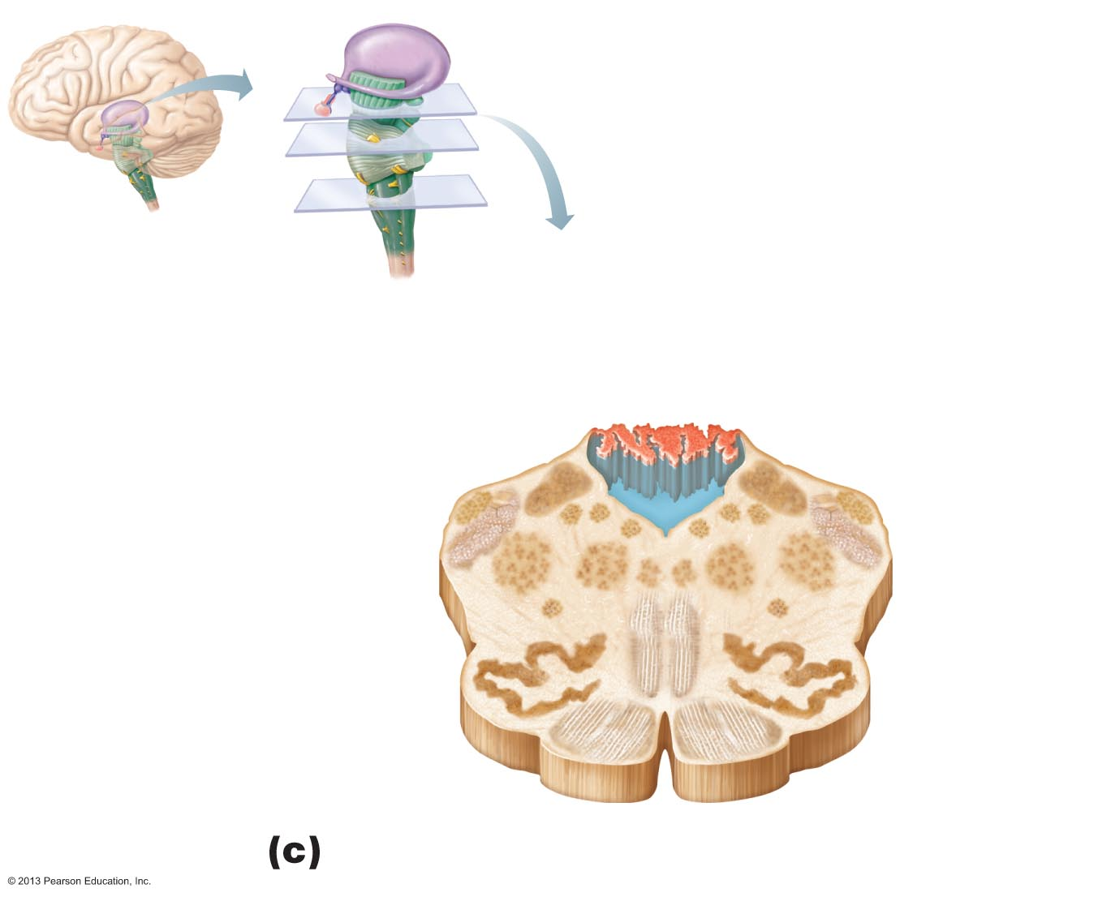
Figure 12.14c Cross sections through different regions of the brain stem.
Fourth ventricle
Solitary
nucleus
Hypoglossal nucleus (XII)
Dorsal motor nucleus
of vagus (X)
Choroid
plexus
Vestibular
nuclei
(VIII)
Inferior cerebellar
peduncle
Cochlear
nuclei
(VIII)
Lateral
nuclear
group
Medial
nuclear
group
Reticular formation
Nucleus
ambiguus
Raphe
nucleus
Inferior
olivary
nucleus
Medial lemniscus
Pyramid
Medulla oblongata

Slide 41
Cerebellum
11% of brain mass
Dorsal to pons and medulla
Input from cortex, brain stem and sensory receptors
Allows smooth, coordinated movements

Slide 42
Anatomy of Cerebellum
Cerebellar hemispheres connected by vermis
Folia—transversely oriented gyri
Each hemisphere has three lobes
  Anterior, posterior, and flocculonodular
Arbor vitae—treelike pattern of cerebellar white matter

Slide 43
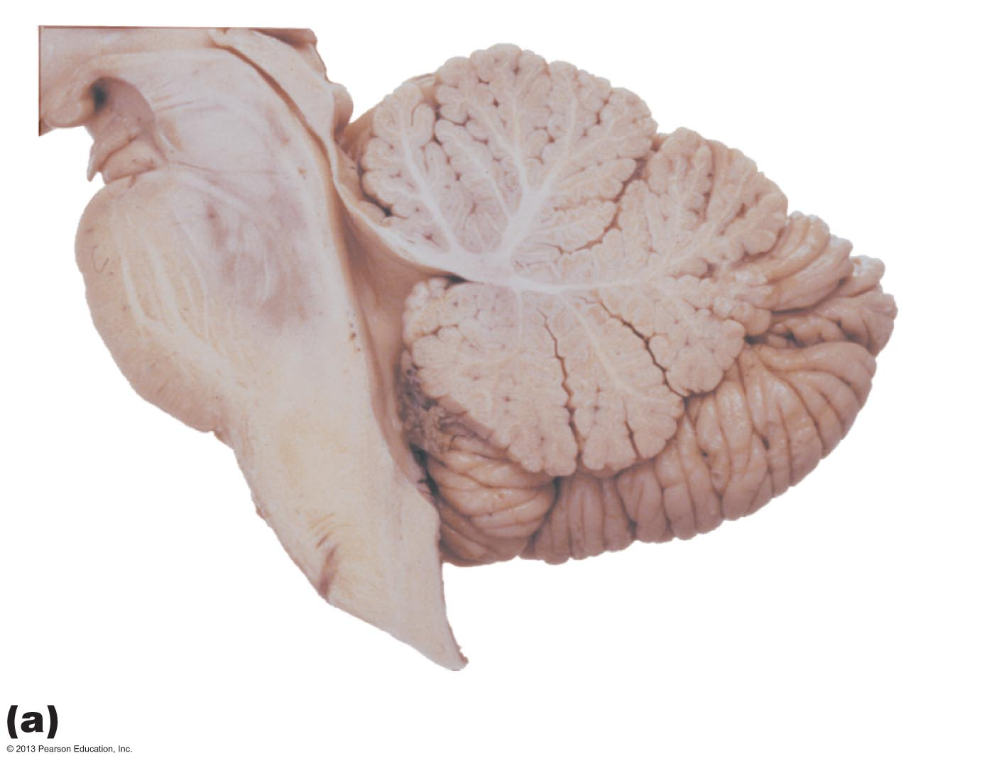
Figure 12.15a Cerebellum.
Anterior lobe
Arbor vitae
Cerebellar
cortex
Pons
Fourth
ventricle
Posterior
lobe
Medulla
oblongata
Flocculonodular lobe
Choroid plexus

Slide 44
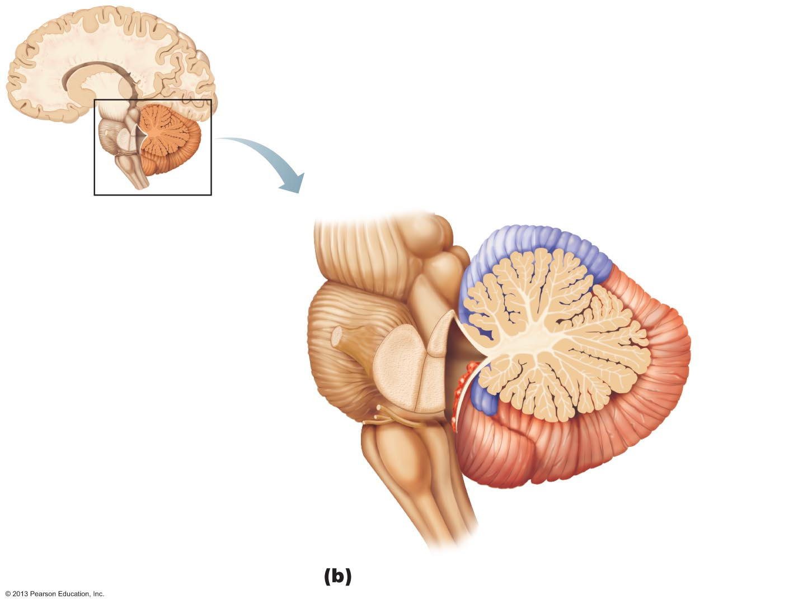
Figure 12.15b Cerebellum.
Anterior lobe
Cerebellar cortex
Arbor
vitae
Cerebellar
peduncles
Posterior
lobe
• Superior
• Middle
Choroid
plexus of
fourth
ventricle
• Inferior
Medulla
oblongata
Flocculonodular
lobe

Slide 45
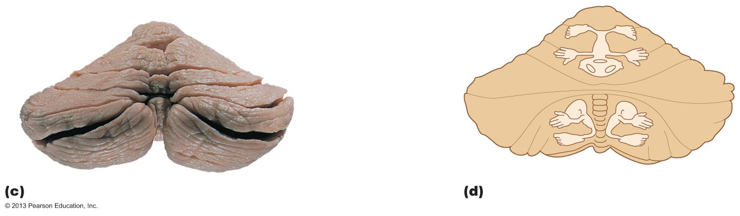
Figure 12.15c–d Cerebellum.
Anterior
lobe
Primary
fissure
Posterior
lobe
Horizontal
fissure
Vermis
Vermis

Slide 46
Cerebellar Peduncles
All fibers in cerebellum are ipsilateral
Three paired fiber tracts connect cerebellum to brain stem
  Superior cerebellar peduncles connect cerebellum to midbrain
  Middle cerebellar peduncles connect pons to cerebellum
  Inferior cerebellar peduncles connect medulla to cerebellum

Slide 47
Cerebellar Processing of Motor Activity
Cerebellum receives impulses from cerebral cortex of intent to initiate voluntary muscle contraction
Signals from proprioceptors and visual and equilibrium pathways continuously "inform" cerebellum of body's position and momentum
Cerebellar cortex calculates the best way to smoothly coordinate muscle contraction
"Blueprint" of coordinated movement sent to cerebral motor cortex and brain stem nuclei

Slide 48
Cognitive Function of Cerebellum
Role in thinking, language, and emotion
May compare actual with expected output and adjust accordingly

